Slide 1
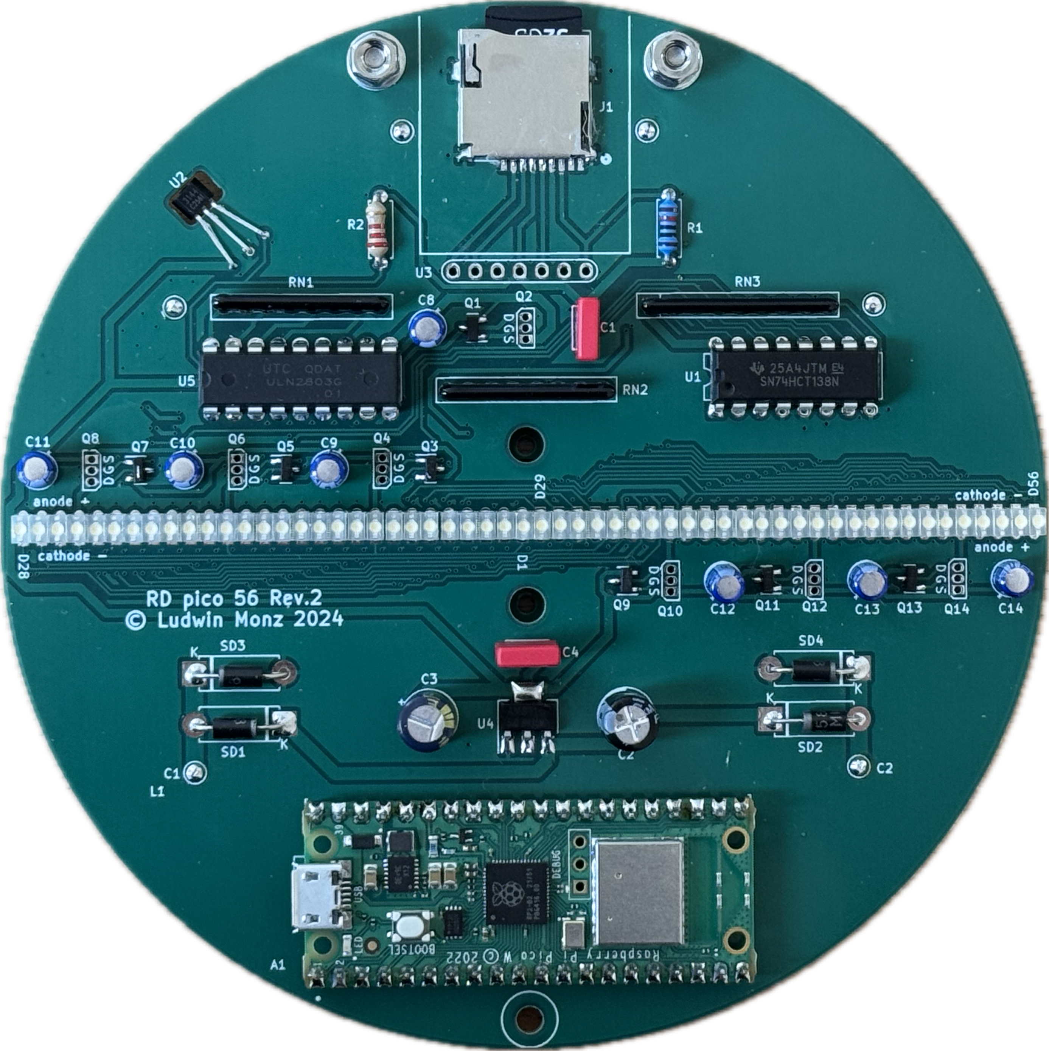
balancing weights

Slide 2
in0
in1
in2
decoder and
level converter
74HCT138
out0 out1 out2 out3 out4 out5 out6 out7
+5V
+5V
Darlington
array
p-channel MOSFET
. . . . . . .
bit 7
bit 6
bit 5
bit 4
bit 3
bit 2
bit 1
bit 0
ULN2803

Slide 3
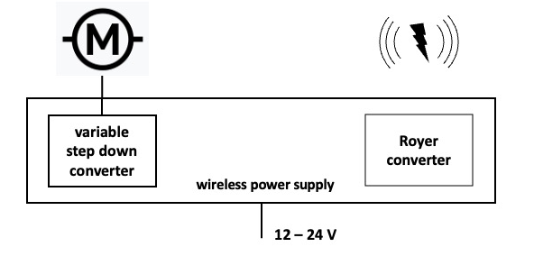

Raspberry Pi Pico W
Hall sensor
GPIO 0…10
74HCT138 encoder
. . . .
Darlington transistor array

Slide 4
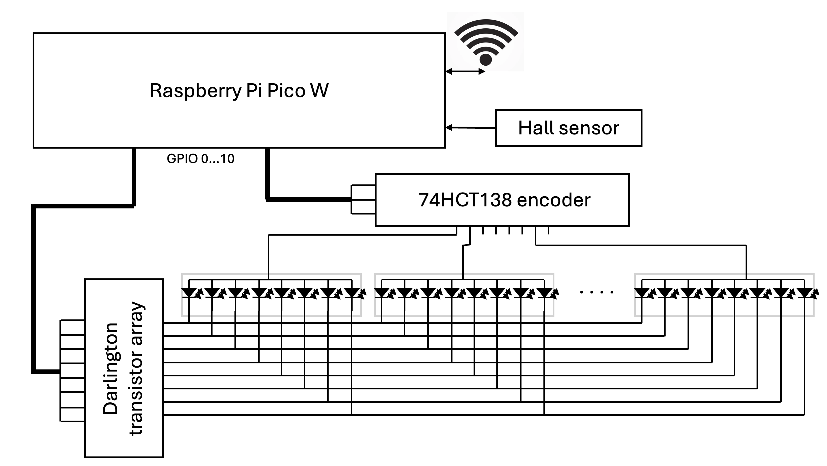
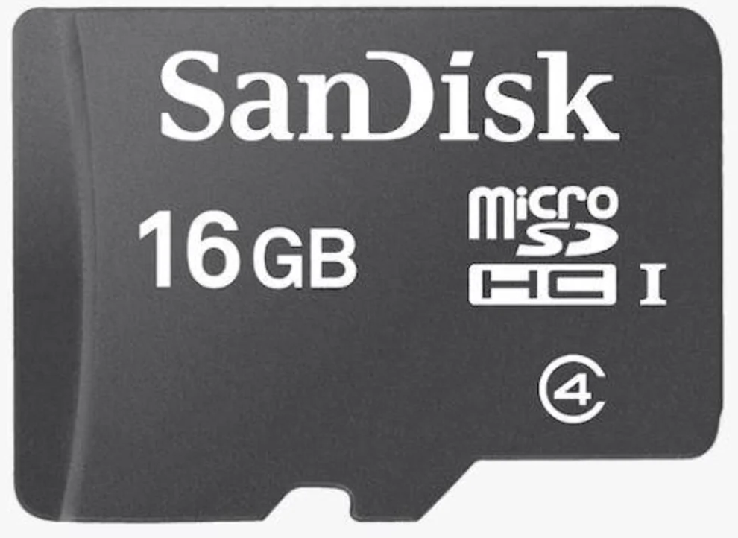

Wifi
micro SD card
variable
voltage
12 V

Slide 5
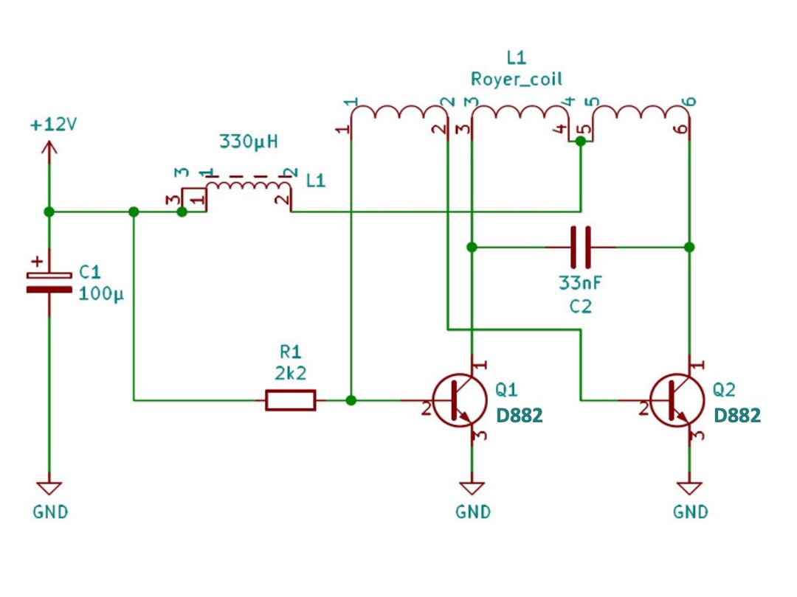
TIP30C
TIP30C

Slide 6
Hall sensor trigger
Hall interrupt
1/turn
100 ms
restart line count
calculate time per turn, program pixel interrupt
pixel interrupt
240/turn
420 µs
subpixel
8/pixel
52 µs
multiplexing columns
7/subpixel
7.5 µs

Slide 7
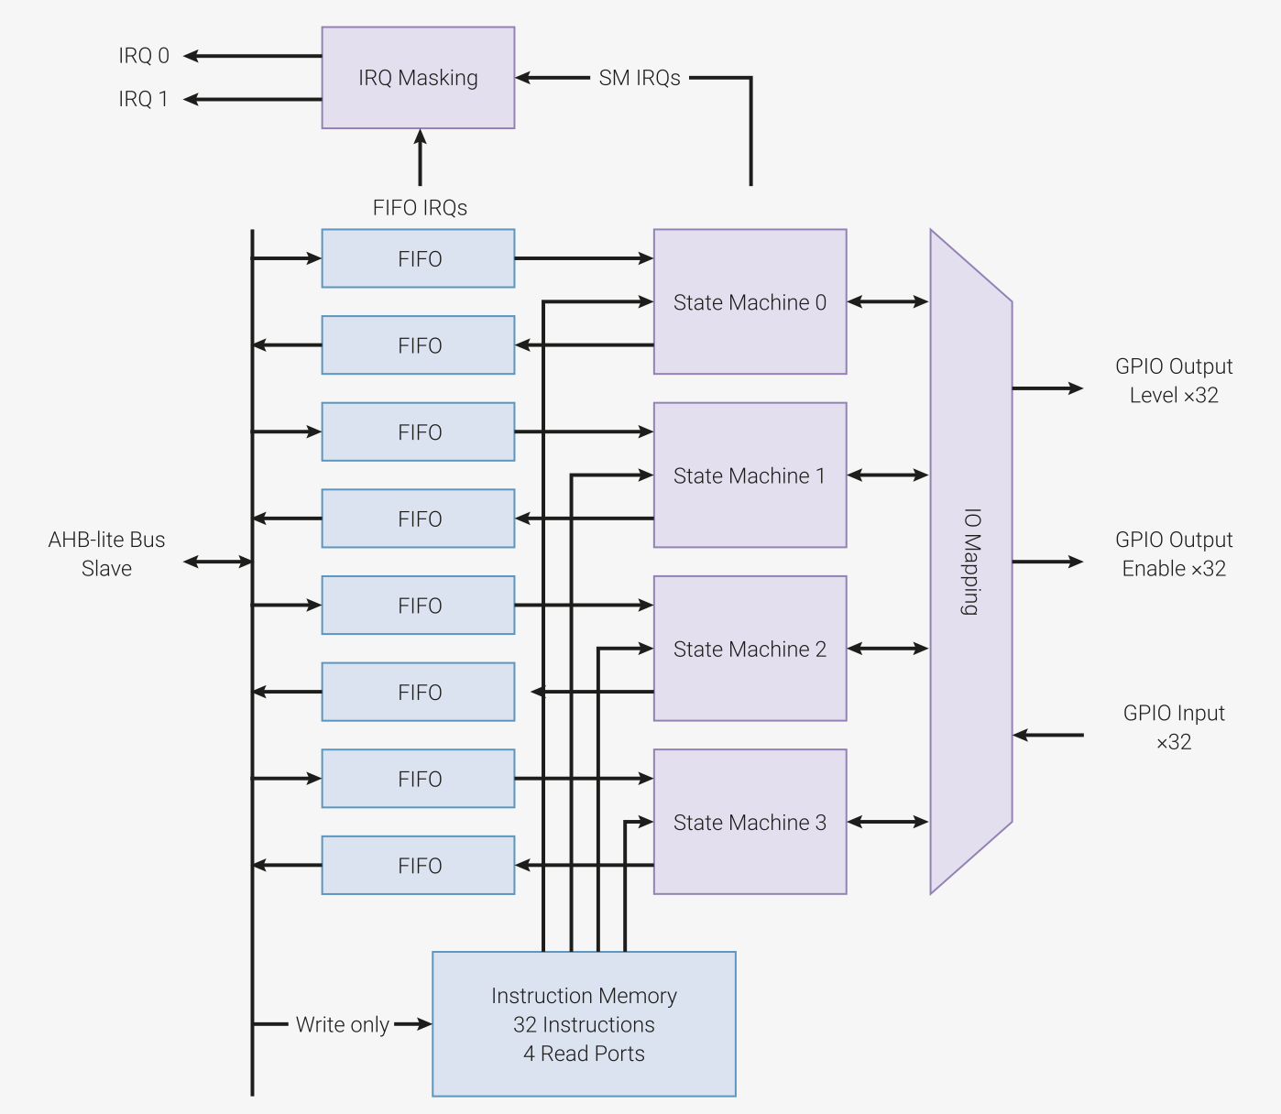
RP2040
programmable IO (pio)
GPIO 0
GPIO 1
.
.
.
.
GPIO 7
GPIO 8
GPIO 9
GPIO 10
column row

Slide 8
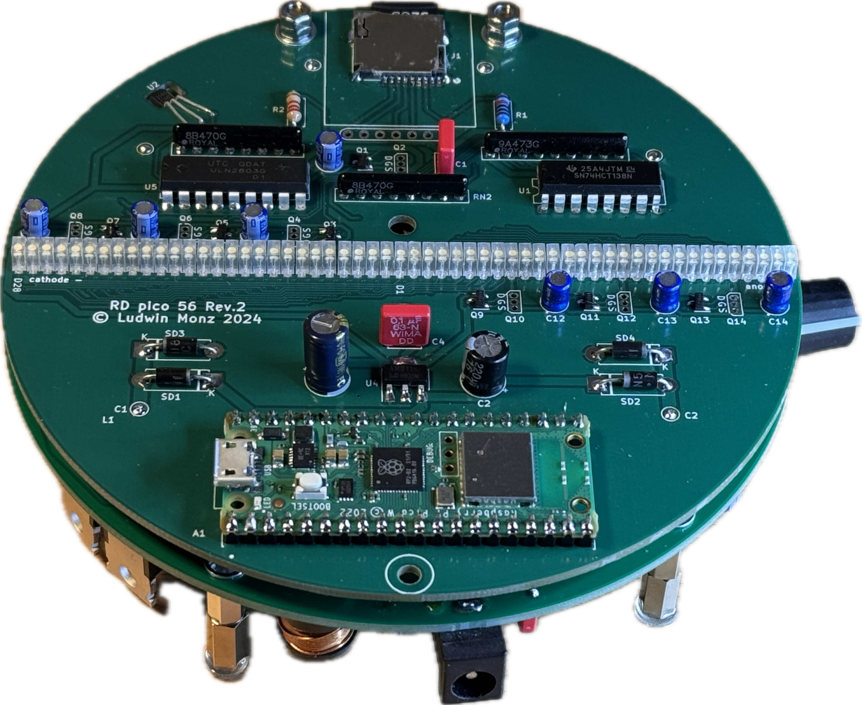

Slide 9
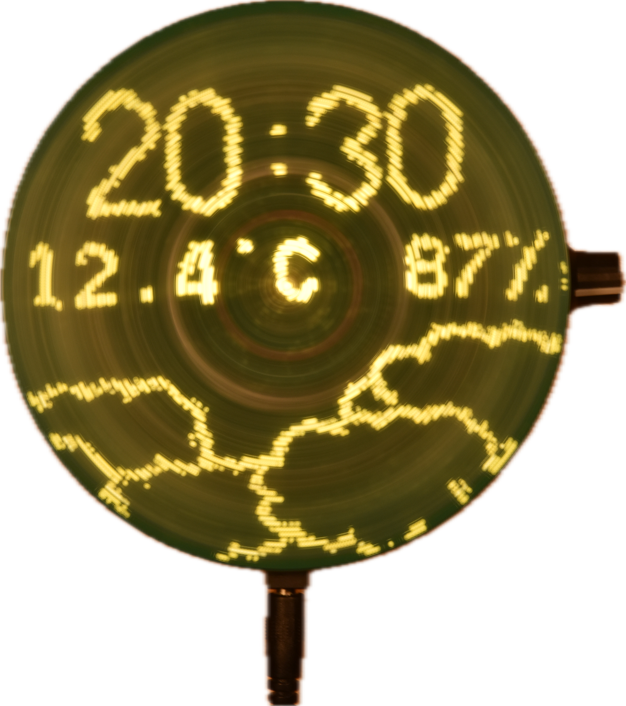
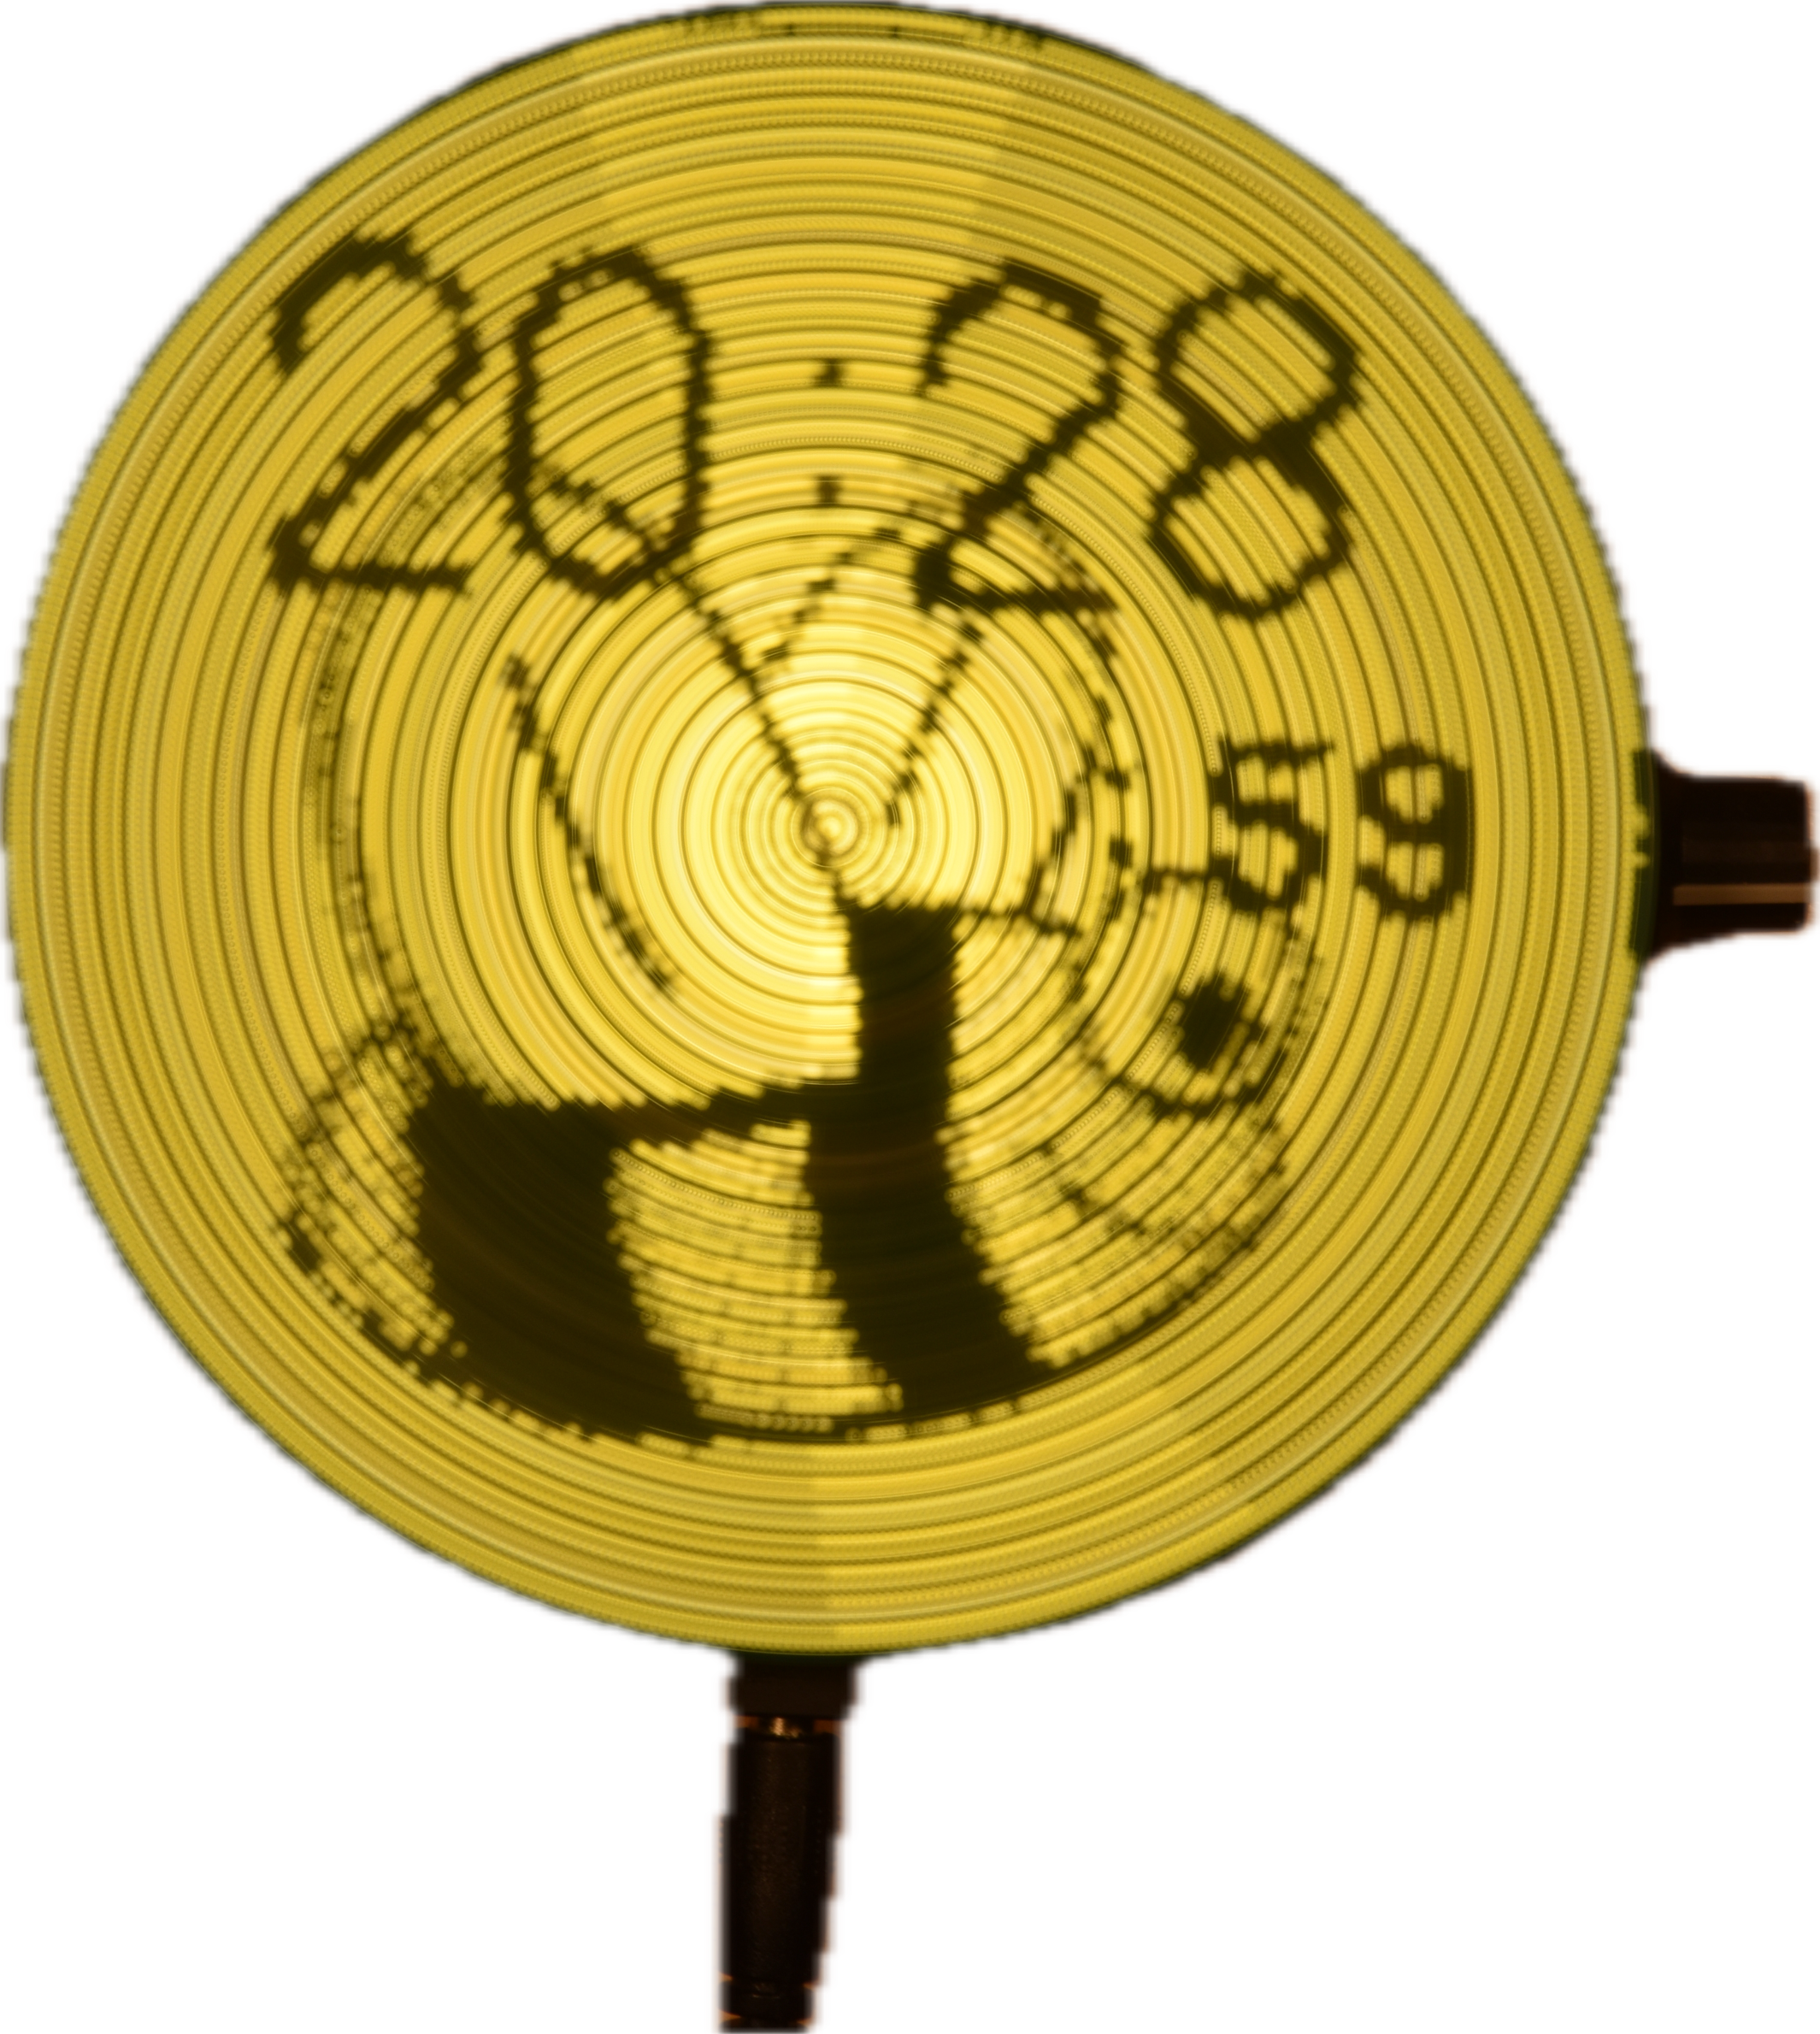
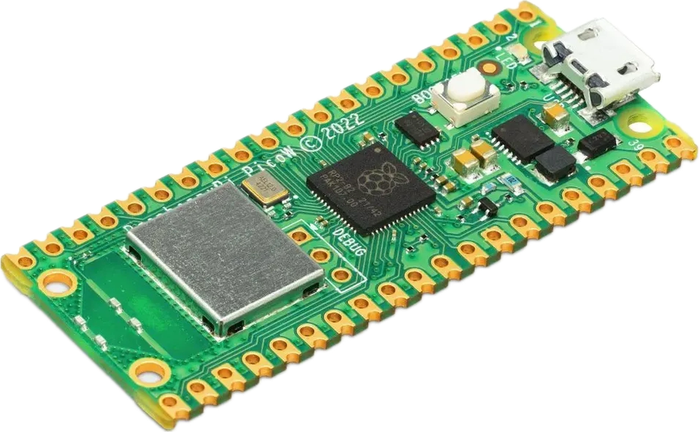
Rotating Display Pico

Slide 10
Rotating Display Pico

Slide 11

Rotating Display Pico

Slide 13
Rotating Display Pico

